Slide 1
Proof Techniques
CSE 2213 – Discrete Mathematics

Slide 2
Proof techniques
Three basic techniques –
Direct proof
Proof by contradiction
Proof by contraposition

Slide 3

Direct proof
To prove $p→q$, we first assume that $p$ is true, and hence prove that $q$ is true
We reach the conclusion directly from our assumption

Slide 4

Example
Give a direct proof of the theorem "If n is an even integer, then $\text{n}\text{2}$
is even.”

Slide 5
Example
Give a direct proof that if m and n are both perfect squares, then nm is also a perfect square.(A perfect square is the square of an integer)

Slide 6
Example Rosen, page 85, exercise 10
Prove that the product of two rational numbers is rational
Note: The real number r is rational if there exist integers p and q with q ≠ 0 such that r = p / q .A real number that is not rational is called irrational.

Slide 7

Proof by contraposition
To prove $p→q$, we first assume that $¬q$ is true, and hence prove that $¬p$ is true
We actually prove the contrapositive of the actual sentence, i.e. $¬q→¬p$

Slide 8

Example Rosen, page 78, example 3
Prove that, for all integer $n$, if $3n+2$ is odd, then $n$ is odd

Slide 9

Example
Prove that if n is an integer and $\text{n}\text{2}$ is odd, then n is odd.
P: n^2 is odd
Q:n is odd
~P: n^2 is even
~Q: n is even

Slide 10
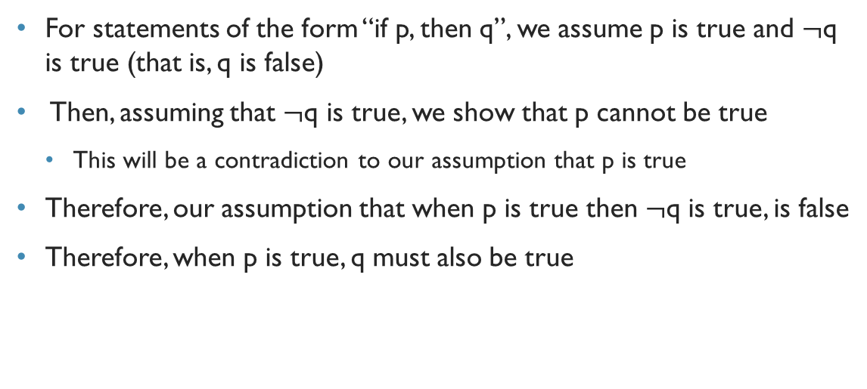
Proof by contradiction
For statements of the form “if p, then q”, we assume p is true and $¬$q is true (that is, q is false)
Then, assuming that $¬$q is true, we show that p cannot be true
This will be a contradiction to our assumption that p is true
Therefore, our assumption that when p is true then $¬$q is true, is false
Therefore, when p is true, q must also be true

Slide 11
Proof by contradiction
Give a proof by contradiction of the theorem "If 3n + 2 is odd, then n is odd.“
We assume that 3n+2 is odd and n is even

Slide 12
Example
Give a proof by contradiction of the theorem "If 3n + 2 is even, then n is even."

Slide 13
Vacuous and trivial proofs
If we prove a conditional statement by disproving its hypothesis, then the proof technique is called vacuous proof
If we prove a conditional statement by proving its conclusion, then the proof technique is called trivial proof

Slide 14
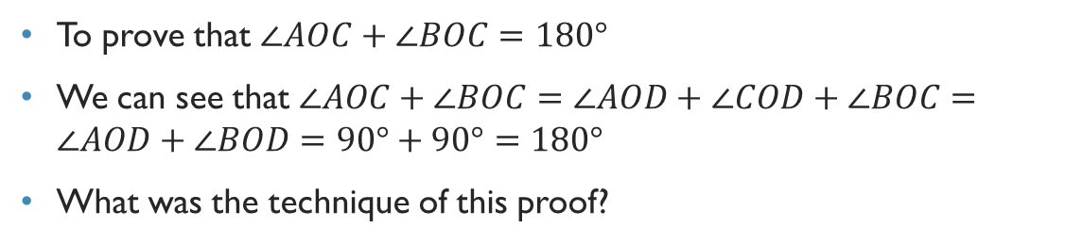
Quick exercise
Is $P\left(0\right)$ true, where $P\left(n\right)≡\left(n>1\right)→(n^{2}>n)$?
Vacuous proof
Is $P(0)$ true, where $P\left(n\right)≡∀a∀b\left(\left(a≥b\right)→\left(a^{n}≥b^{n}\right)\right)$?
Trivial proof

Slide 15
Disproving universally quantified propositions
Prove that “Every positive integer is the sum of the squares of two integers” is false.
We just find a counterexample, that invalidates the use of “every” in the sentence
Here, a counterexample is 3 (because 3 = 1 + 2, and 2 is not the square of any integer)

Slide 16

Example Rosen, page 85, exercise 5
Prove that, if $m+n$ and $n+p$ are even integers, then $m+p$ is also even
Notes:
Doable by direct proof

Slide 17
Example
Proof by contradiction: “if mn even, then m even or n even”.

Slide 18

Example Rosen, page 85, exercise 13
Prove that, if $x$ is irrational, then $\frac{1}{x}$ is also irrational. (Given that 1/x will never be equal to 0)
Notes:
Doable with contraposition Additionally, also need to proof that x is non-zero, since 1/x exists

Slide 19
Example Rosen, page 85, exercise 9
Prove that the sum of an irrational and a rational number is irrational
Notes:
If a is a rational number and i is an irrational number, then a + i is irrational
Prove by contradiction
Assume a + i to be rational a number, s.
Then a + i = s
And i = s – a
But the addition/subtraction of two rational numbers s and i should also be a rational number, making i a rational number.
This contradicts our assumption that i is irrational Therefore, a+ i is irrational

